Slide 1

THE NATIONAL CYBERCHAMP COMPETITION 2023
(NCCC23)
ZONAL CHALLENGE
ETHICAL HACKING SESSION
DATE: 21 JANUARY, 2023

Slide 2
THE NATIONAL CYBERCHAMP COMPETITION 2023
(NCCC23)
ZONAL CHALLENGE
ETHICAL HACKING SESSION
GLAGO GIDEON ELORM
21 JANUARY 2023.

Slide 3
PROJECT REQUIREMENTS
The CIO of New Wave Commercial Bank Ltd, Mohamed Ayala, has been asked by his board of directors to carry out quarterly assessments to meet security compliance mandates. The bank has hired you and your team to carry out a black box penetration testing engagement on one of the host machines owned by the bank

Slide 4

OUTLINE SHOWING STAGES OF THE ENGAGEMENT
Stage 1: Scanning and enumeration phase
Stage 2: Vulnerability assessment phase
Stage 3: Exploitation phase
Stage 4: Data exploration phase
Stage 5: Recommendations
Etc.

Slide 5
Scanning & Enumeration (1/2)
Output 1:
IP address of the attacker machine
192.168.56.103

Slide 6
Scanning & Enumeration (2/2)
Output 2:
IP address of the target machine
192.168.56.104

Slide 7
SERVICES IDENTIFIED & POTENTIAL VULNERABILITIES
Service 1: Secure shell
Potential Vulnerabilities:
-Openssh version 2.9 outdated
-Ssh grants access to unauthorized users to gain remote access to the machine.
Service 3: Netbios-ssn
Potential Vulnerabilities: smb version 2.2.1a outdated
Service 4: HTTP
Potential Vulnerabilities: Data being sent on this service is unecrypted.
Service 5: HTTP
Potential Vulnerabilities: Apache version is out of date

Slide 8
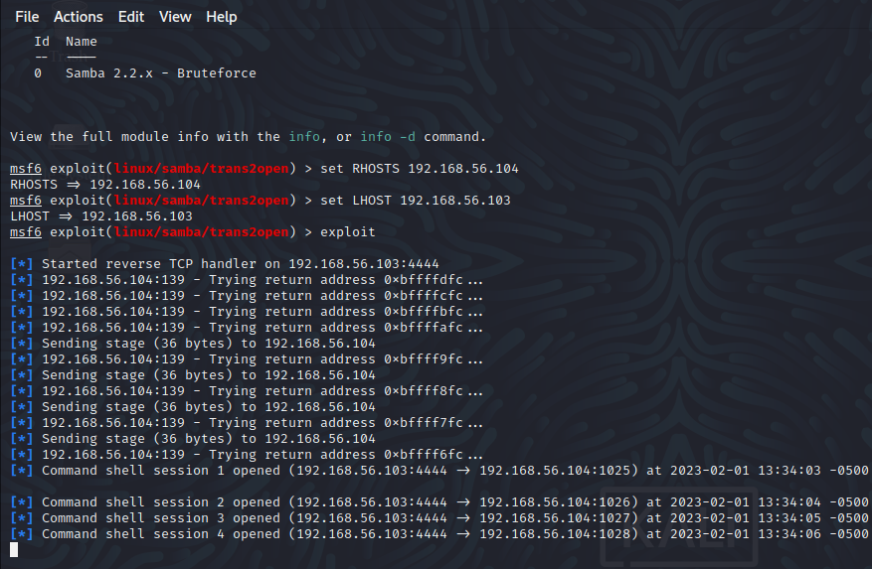
EXPLOITATION OF VULNERABILITIES
Exploitation of Vulnerability 1: Samba version 2.2.1a

Slide 9
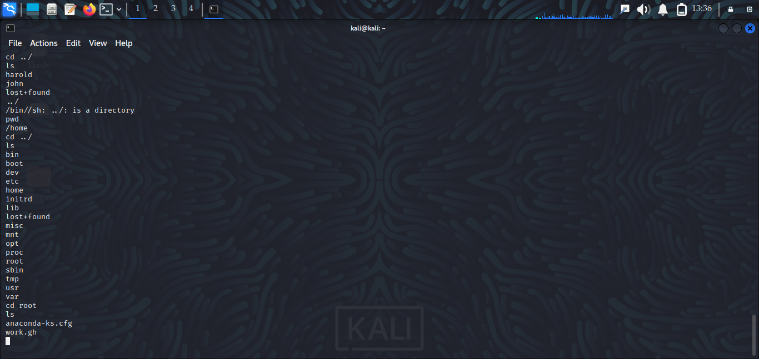
DATA EXFILTRATION/EXPLORATION/EXPOSURE
Output 1: Directories in the target machine

Slide 10
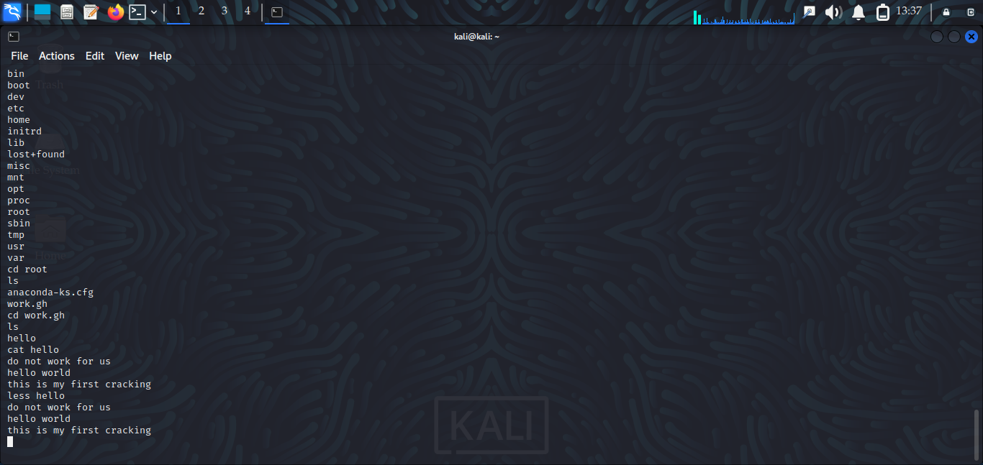
DATA EXFILTRATION/EXPLORATION/EXPOSURE
Output 2: Files on the target machine

Slide 11
SUMMARY OF VULNERABILITIES UNCOVERED
Vulnerability 1: The version of Secure Shell (ssh) running on port 22 is out of date (i.e. open ssh version 2.9 ).
Vulnerability 2: The version of Samba (smb version 2.2.1a) running on port 139 is out of date.
Vulnerability 3: Data being sent using the HTTP protocol is unencrypted.
Vulnerability 4: Files on the machine are unencrypted.
Vulnerability 5: The service Secure Shell running on port 22 grants remote access to unauthorized users.

Slide 12
RECOMMENDATIONS/CONCLUSIONS
Recommendation 1: The ssh service should be updated to Openssh version 9.1
Recommendation 2: Port 80 should be closed
Recommendation 3: Samba version 2.2.1a should be updated to version 4.17
Recommendation 4: Port 22 should be closed.
Recommendation 5: Data stored on the machine should be encrypted.

Slide 13
End of Presentation
THANK YOU

